Slide 1

Stock Sector Analysis
Presenters:
Brittany Jacques
Debolina Mukherjee
Paul Rodriguez
Date:
10-12-2021

Slide 2
Motivation & Summary Slide
The motivation behind our analysis is to determine the best return on investment if we invested an initial $10,000.00 between four market sectors, allocating $2500 to each.
As team we chose Pharmaceuticals, Consumer Goods, Automobiles, and Technology. The reasoning behind this decision was due to the unprecedented effect that the COVID-19 Pandemic had on these specific sectors.
Within these sectors we analyzed three well-known companies in order to gather snapshot data on each sector’s performance.
Once we arrive at a finding, we wanted to indicate which sector gave better returns to investor on their investment or rather a portfolio mix.
This would also serve as a reference or indicator to market behavior for future investments.
Notes:
Brittany

Slide 3
Questions & Data
Which sector gave the highest rate of return on investment during pre-pandemic, peak, post-pandemic?
Our reason to study this data within this timeframe as this was a novel situation, which was faced globally and impacted every market sector and individual lives.
We collected the closing prices of 3 different stocks from four sectors utilizing Yahoo Finance. Ultimately being satisfied with our findings.
We assumed that the Pharmaceutical sector would give the highest return but found that it did provide a return that we did not expect.
Notes:
Brittany

Slide 4
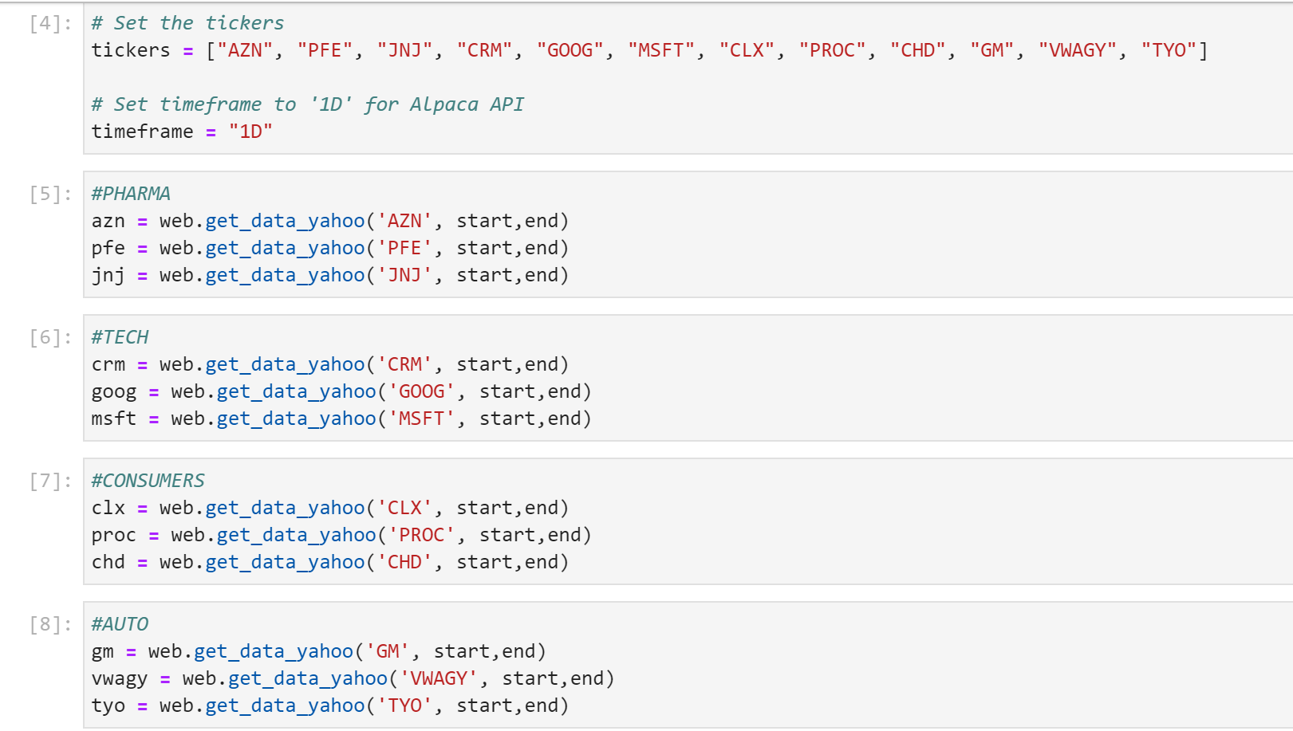
Data Cleanup
Determined how we would gather initial stock data (e.g.CSV, Google Finance, Yahoo Finance API)
The Yahoo Finance API was more dynamic – allowed a more seamless pull of data vs. consolidating data into CSV files.
Initially we had the issue how to get the API to work
Also faced challenges in making Pandas libraries work like Data-reader and hvplot.
Presenting the plot with a 18-month time horizon for the x-axis(Date)
Notes:
Brittany

Slide 5
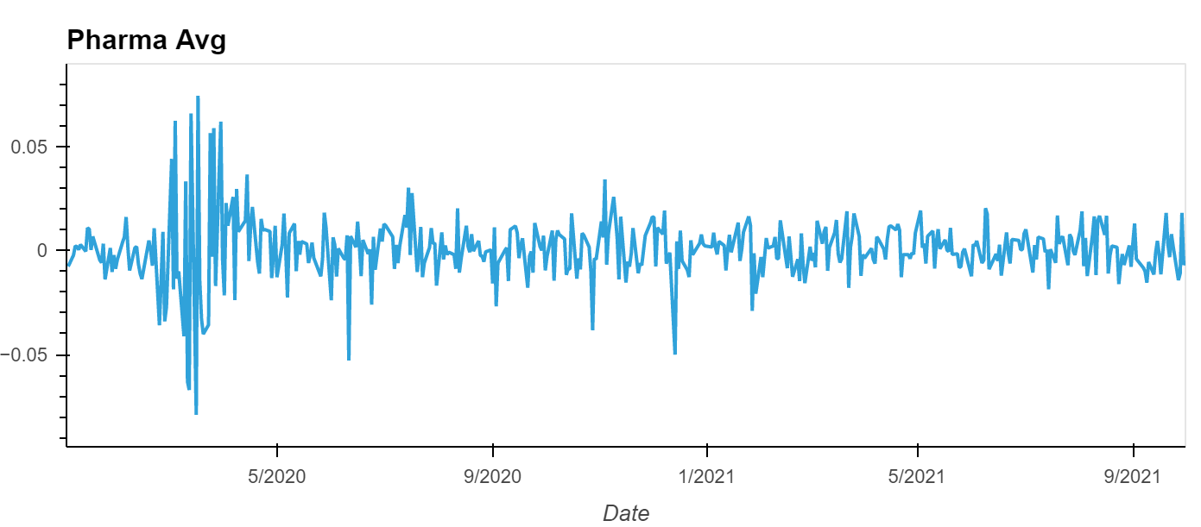
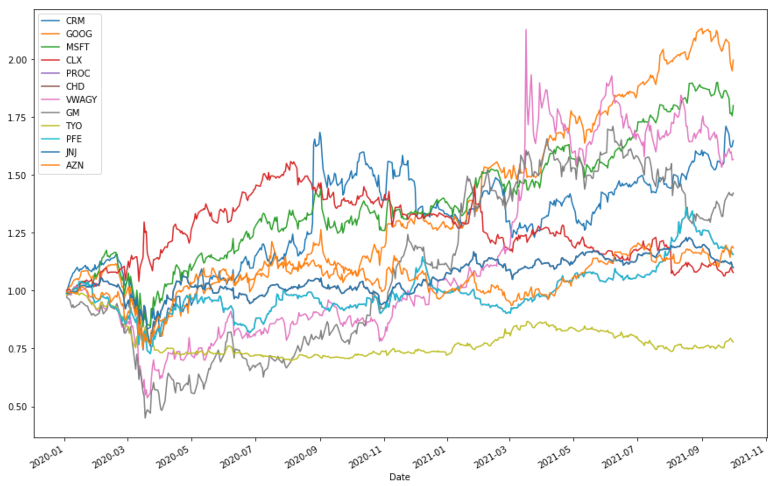
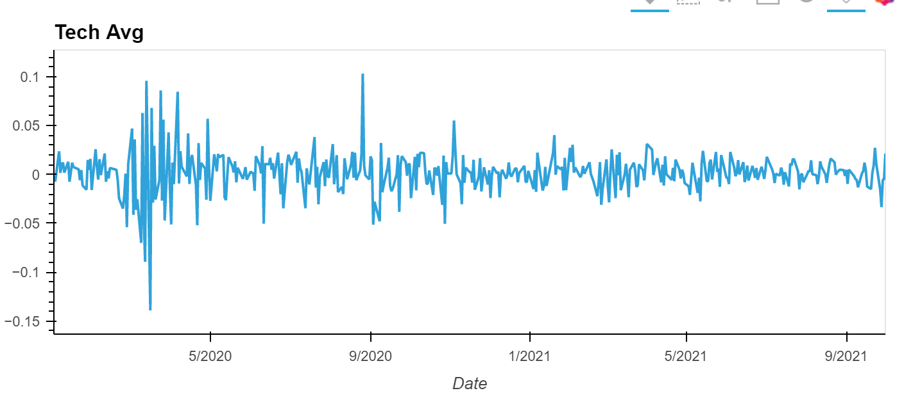
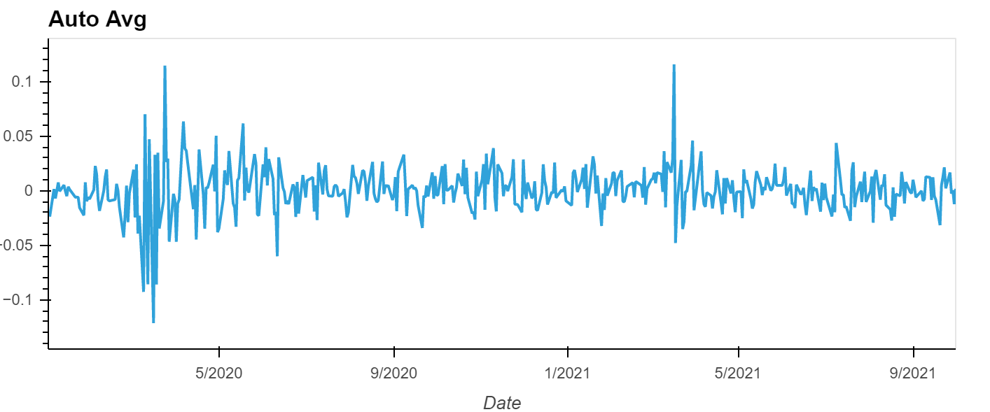
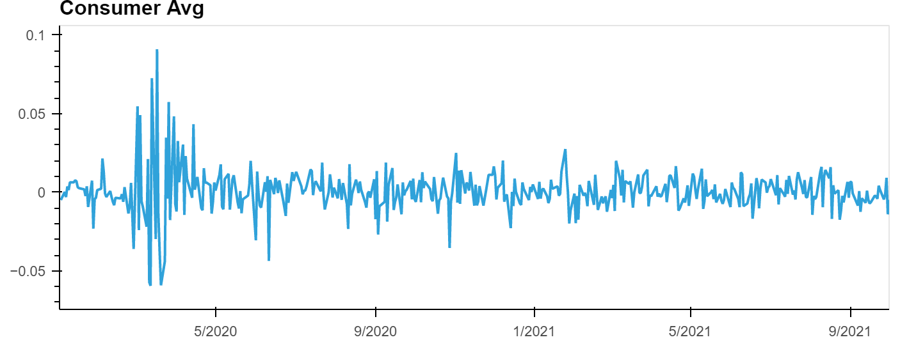
Exploration
Initially to compare each individual stock’s performance but found that it was not indicating a clear trend
Thereby we moved the focus of our analysis on the average performance of the sectors
Notes:
Debolina

Slide 6
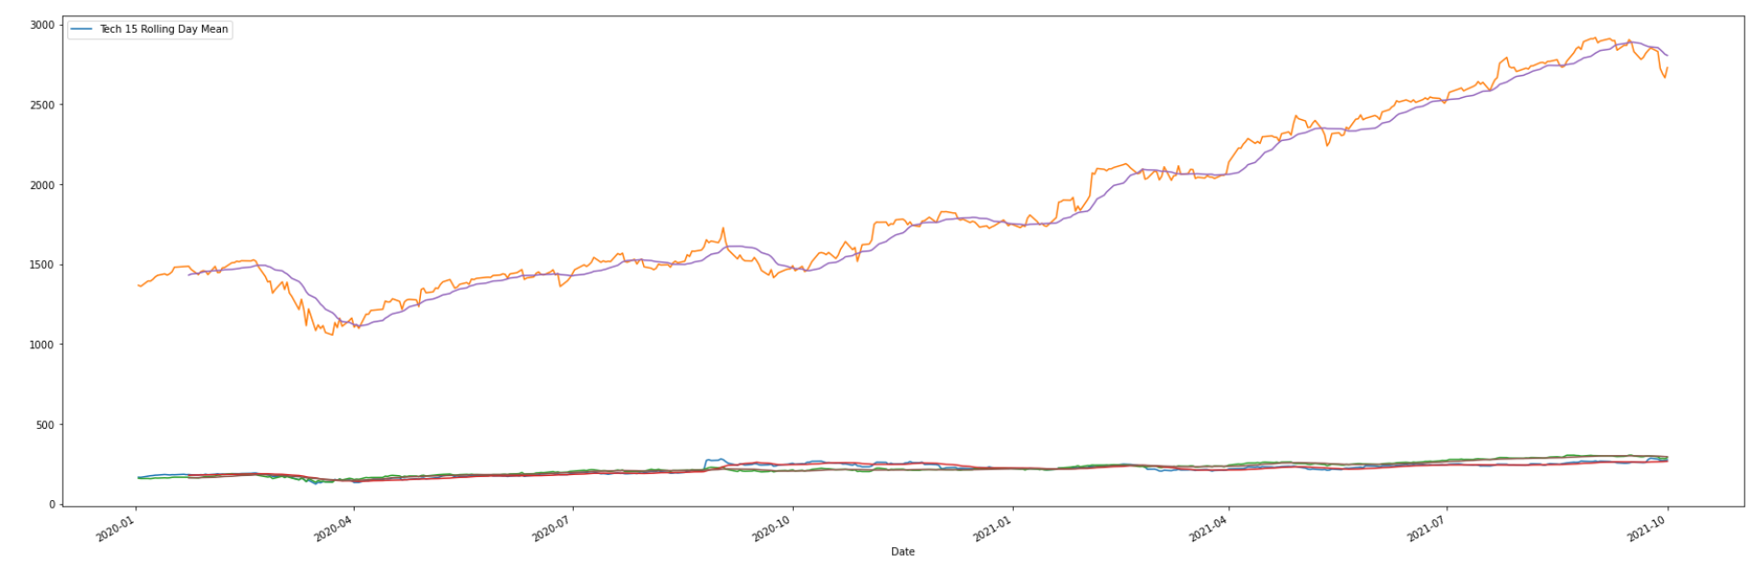
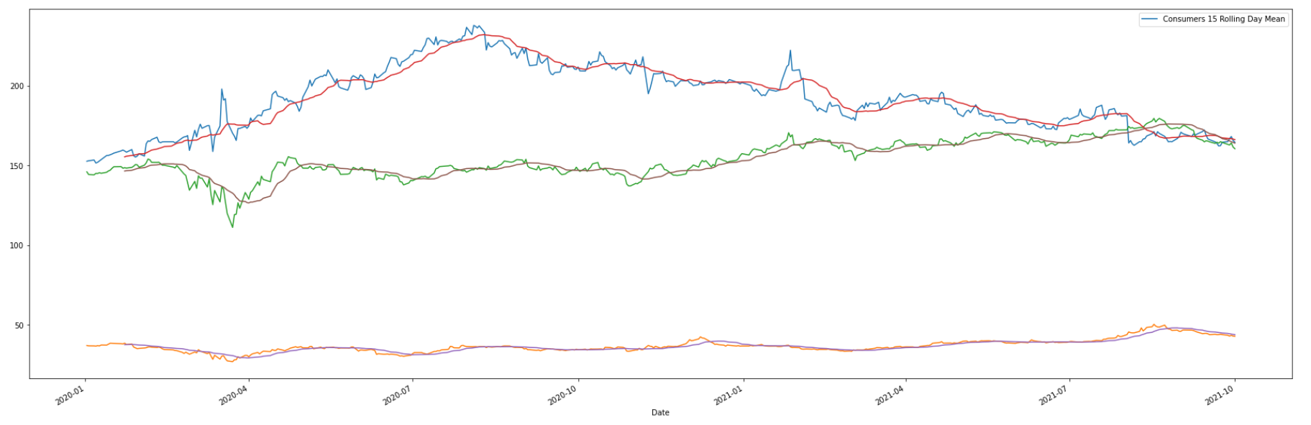
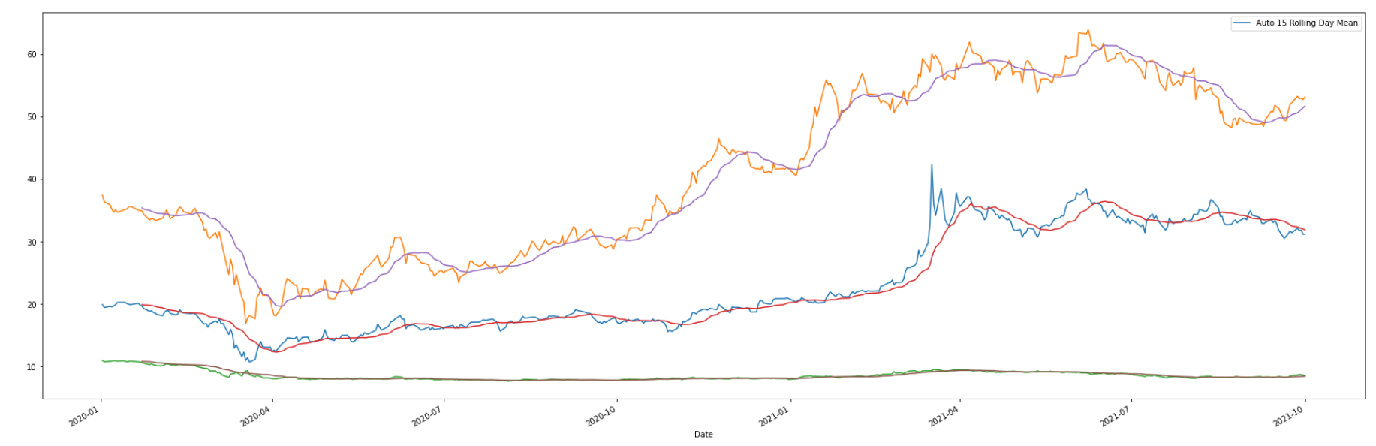
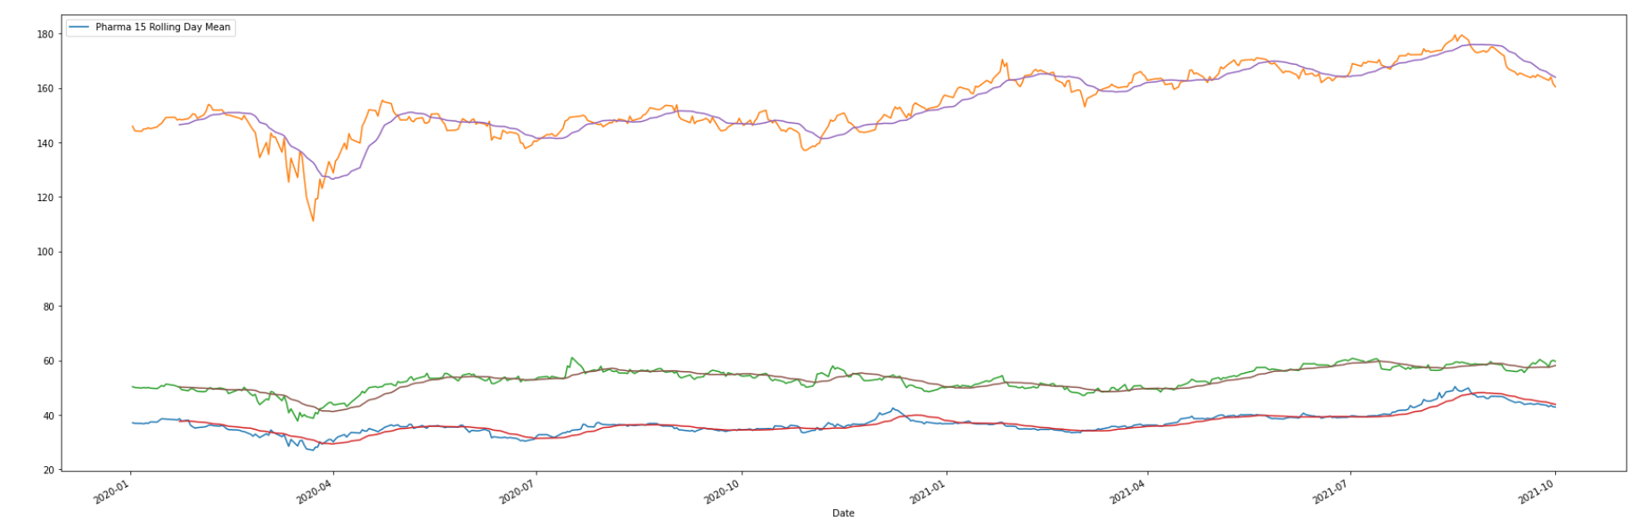
DaTA analysis
The following graphs are a rolling mean of each individual sectors and the performance of each stock within them.
This is to provide a clearer visualization of the stock trends within each sector.
Notes:
Debolina
The rationale behind this slide was to visualize an analysis of the intra-sector performance of each sector.
The evolution of our data collection – we implemented many different types of graphs in our initial process in order to find our end results.

Slide 7
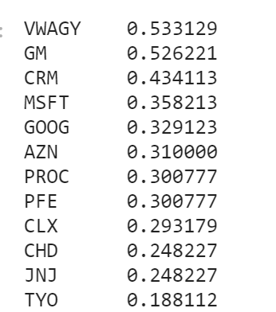
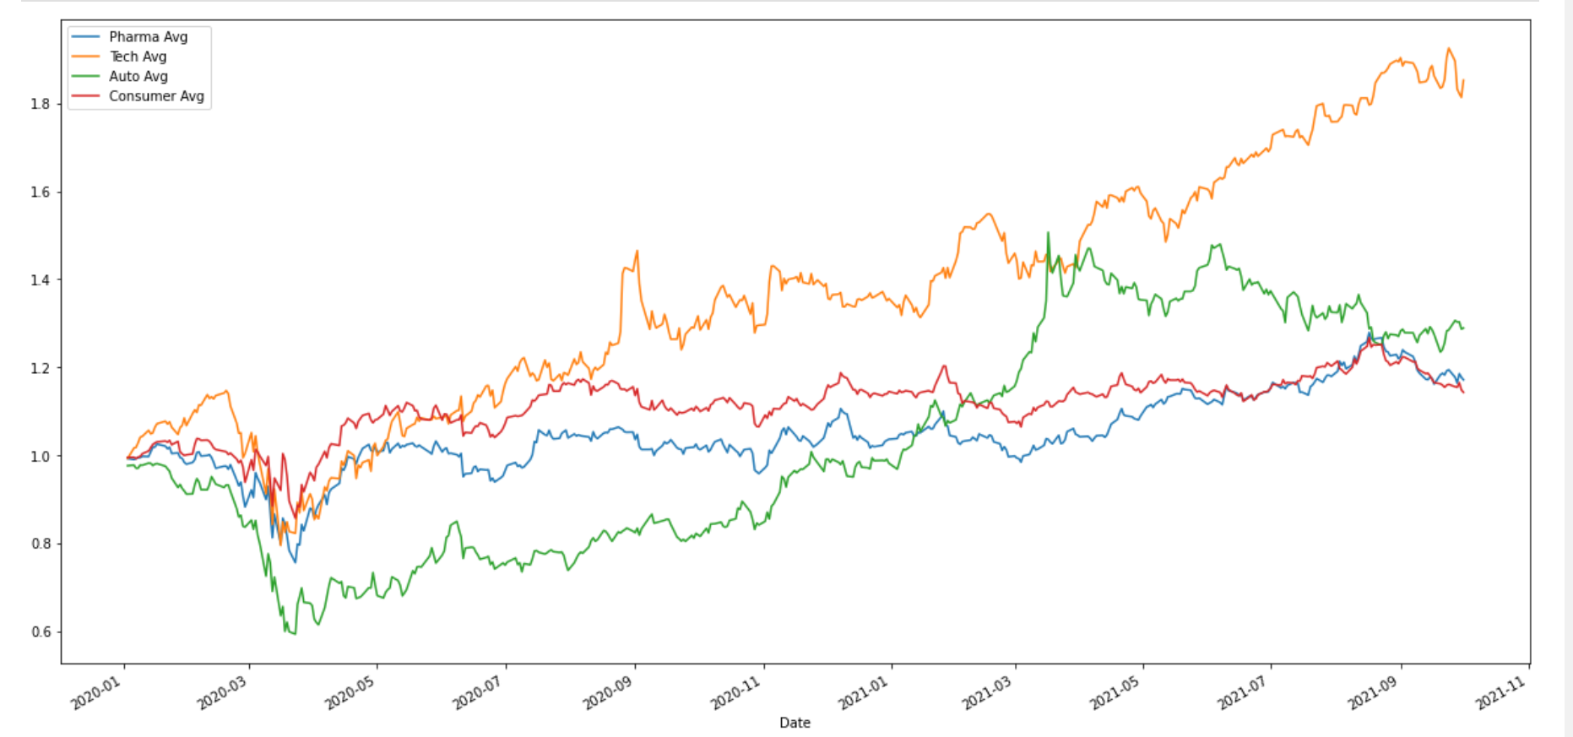
Data Analysis
Across all sectors we compared the data and identified the volatility.
The average stock prices from the 4 sectors and compared the percentage change and the figure here shows the trend in the given time-frame
Notes:
Debolina

Slide 8
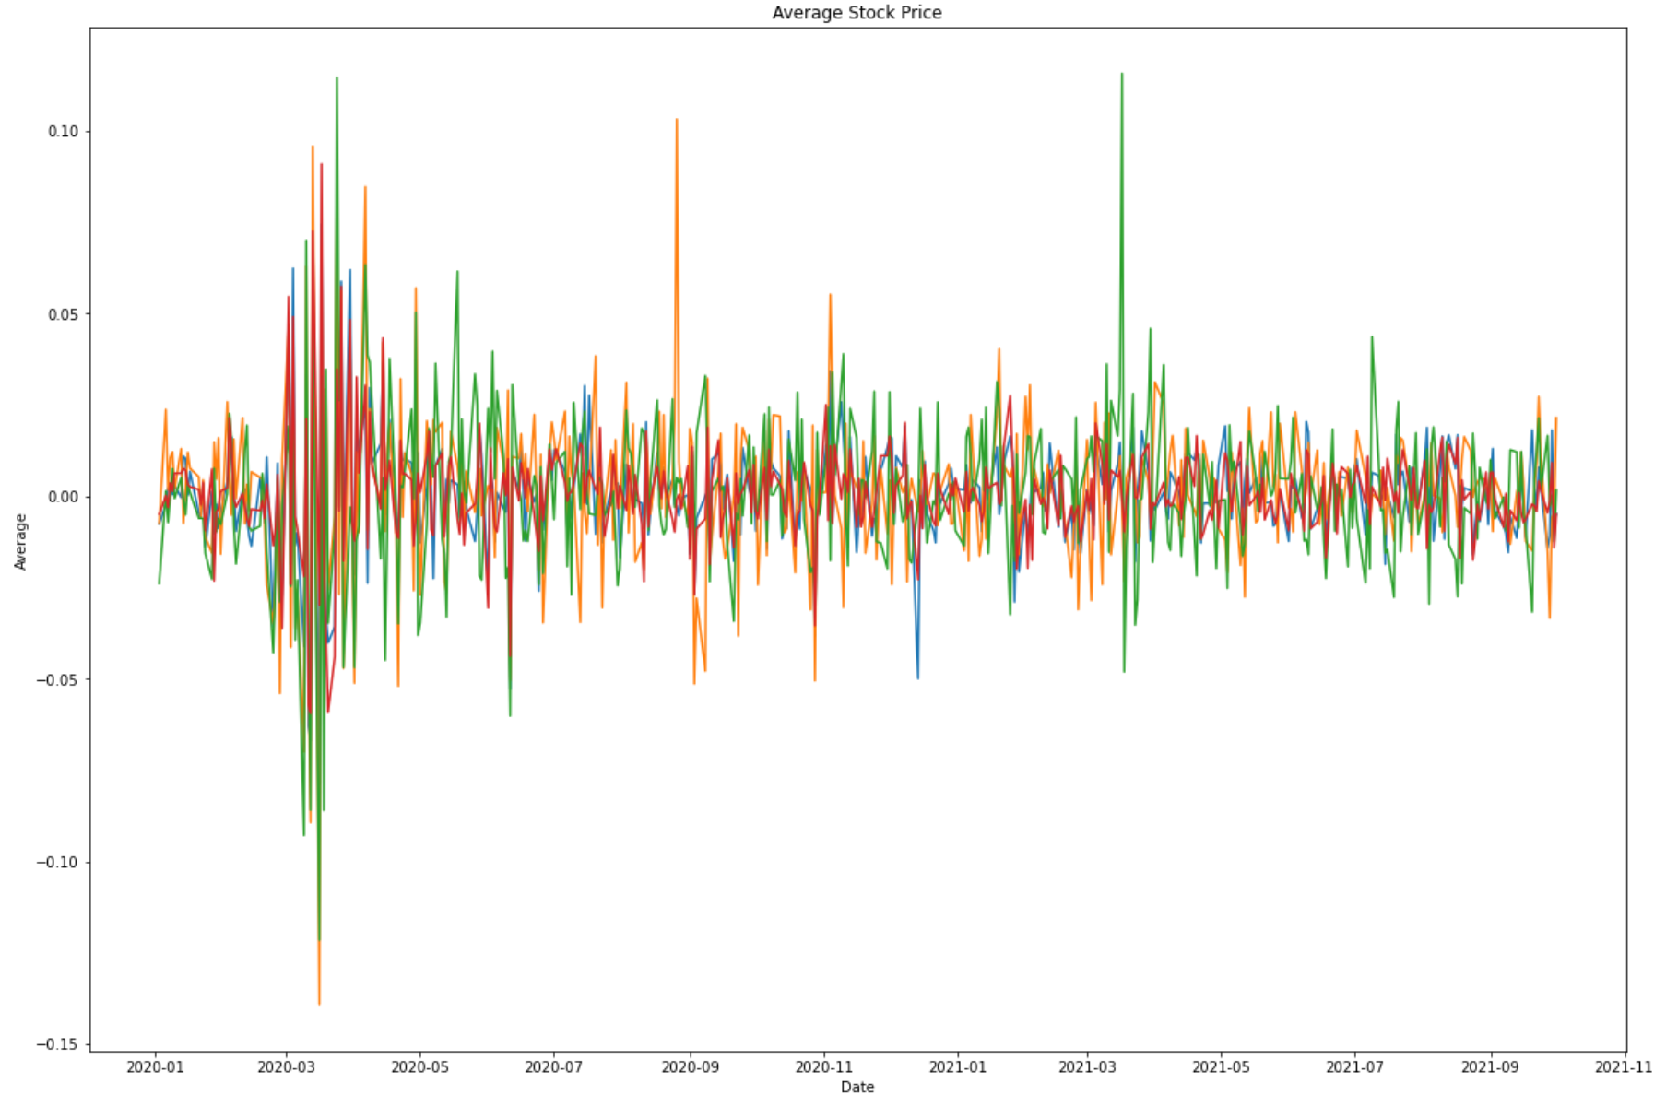
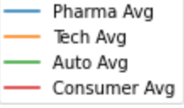
Discussion
Volatility
Notes:
Paul
This graph highlights the performance of our 4 chosen sectors from 01/2020 to 09/2021. This covers pre-pandemic, peak, and post-vaccination phase and the market behavior related to it. As shown, initially there was a lot of volatility across all sectors and gradually it settled. However, assessing each individual sector we see that auto was the most volatile in this time period whereas consumers remained stable, followed by Pharma. Lastly it can be deduced that Tech showed a dominant behavior within the market.

Slide 9
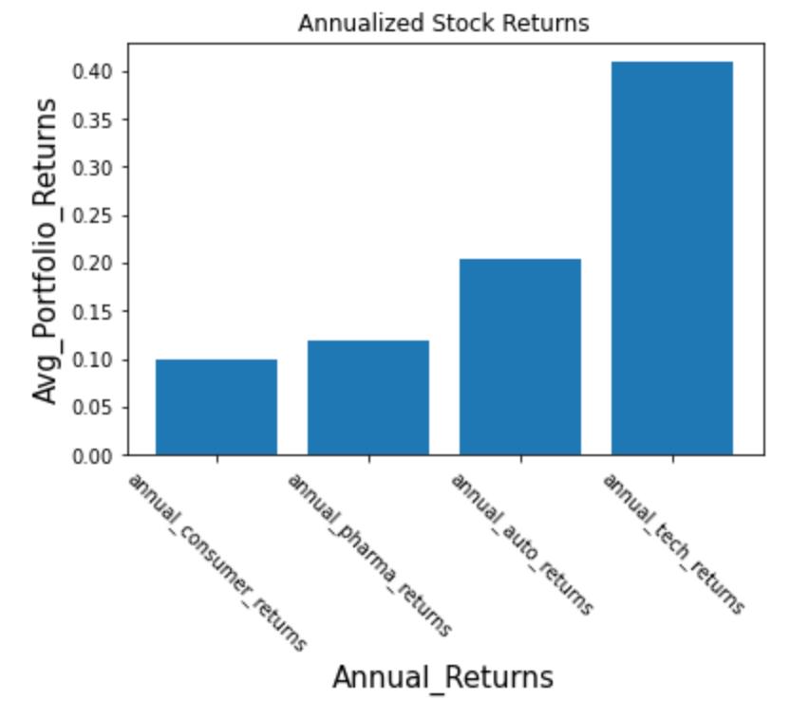
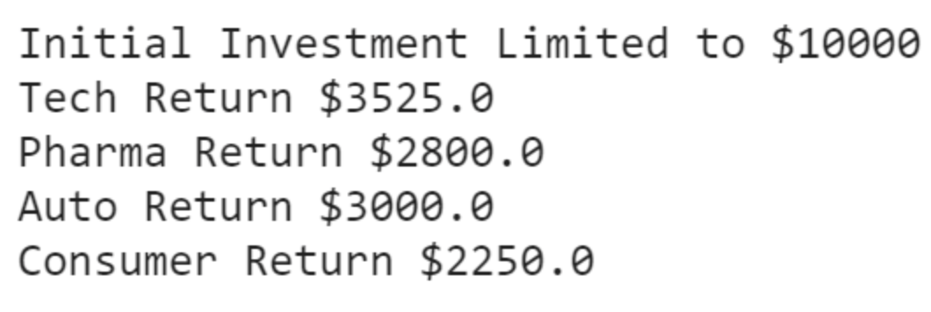
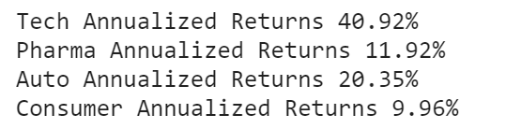
Data Analysis& Result
We calculated the annualized return of each sector and arrive at a point where we could indicate which was the profitable and advisable investment in this horizon
The findings are listed below:
Notes:
Paul

Slide 10
Postmortem
One difficulty we ran into was formatting the x-axis on a graph that compared each market sector. When adjusting the fig size the dates on the x-axis continuously repeated itself. As a team we decided to utilize a similar graph that automatically formatted the x-axis.
If we had more time, we could have explored a forward-looking view on the performance of these sectors,
Additionally, we could have expanded on the number of sectors to have a broader landscape to analyze.
Notes:
Paul

Slide 11

Questions
Any questions?

Slide 12
References
https://stackoverflow.com/
https://github.com/brittanyjacques/Group-Project-1
https://yahoofinance.com/

